Slide 1
Welcome
to
my
presentation

Slide 2


Md. Jakir Ahammed
ID : 1913051
Reg No. :000013283
Department of Chemistry
Begum Rokeya University,
Rangpur.

Slide 3

Topic
1. Ionization potential
2. Election Affinity
3. Atomic Radii
4. Ionic Radii

Slide 4
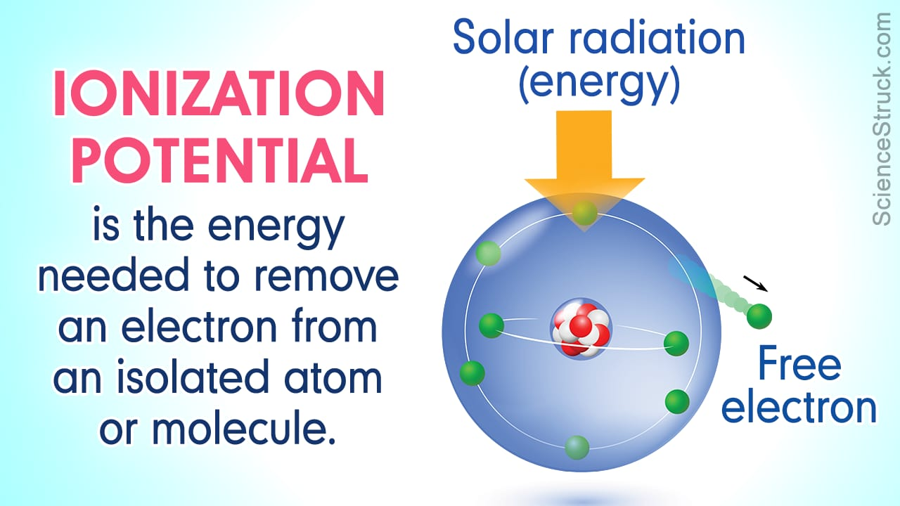

Slide 5
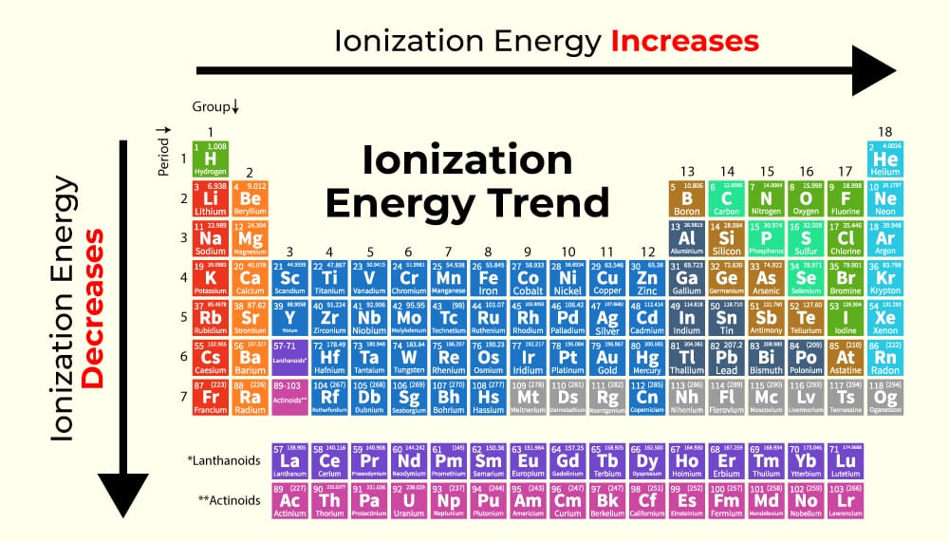

Slide 6
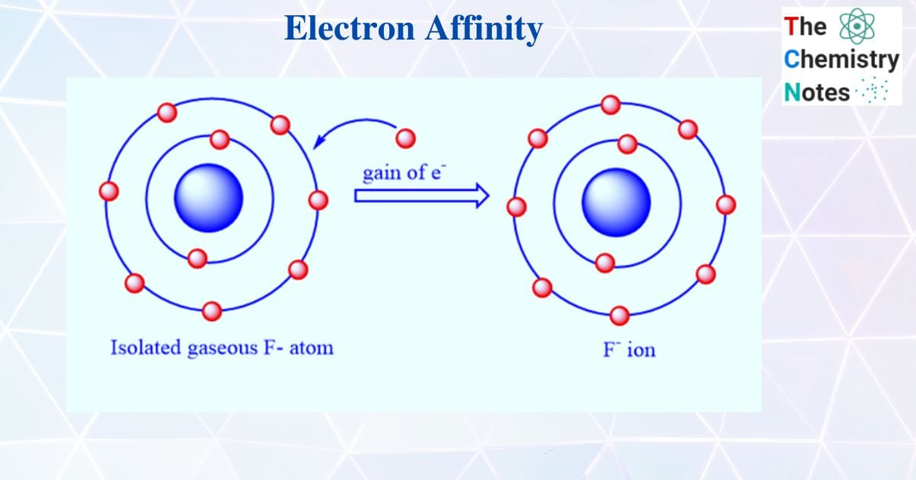
Electron Affinity
The electron affinity of an element is defined as the energy released when an electron is added to an isolated gaseous atom to form a gaseous anion or negative ion.

Slide 7
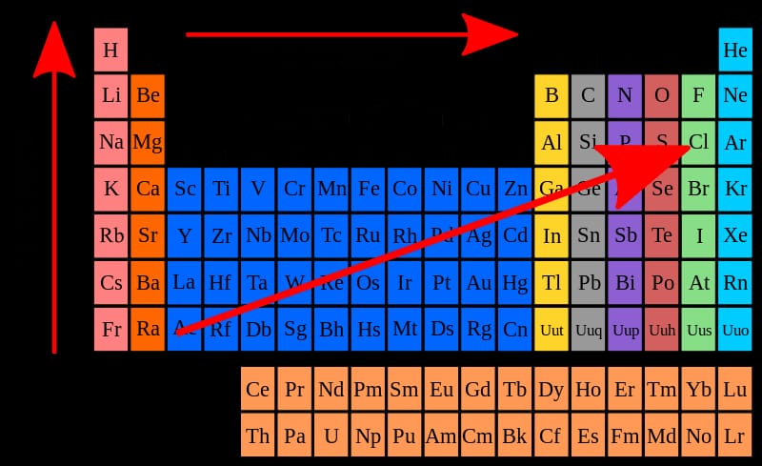
Periodic trend of electron affinity
Increase
Increase

Slide 8
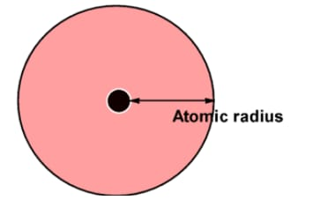
Atomic radii
The atomic radii of an element is a measure of the size of an atom
It is the distance between the nucleus of an atom and the outermost electron shell.

Slide 9
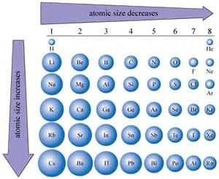
Periodic trend of atomic radii

Slide 10
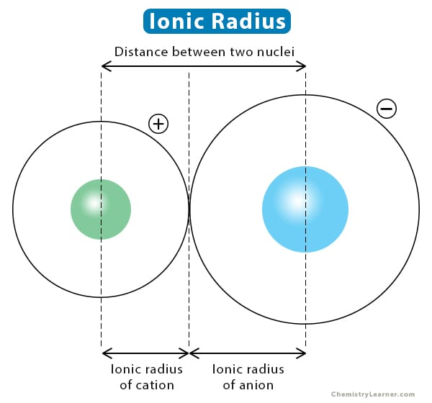
Ionic Radius
The ionic radii of an element is a measure of the size of an ion.
the distance from the nucleus of an ion up to which it has an influence on its electron cloud.

Slide 11
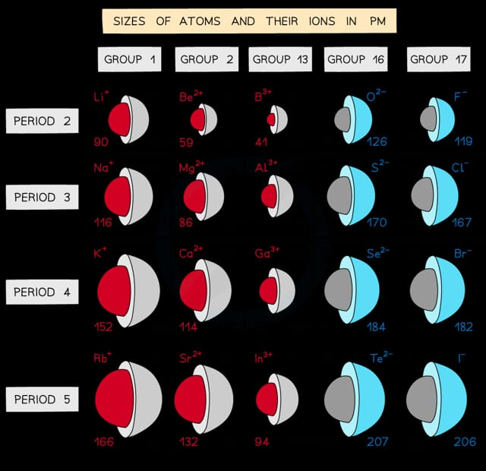
Periodic trend of ionic radius

Slide 12
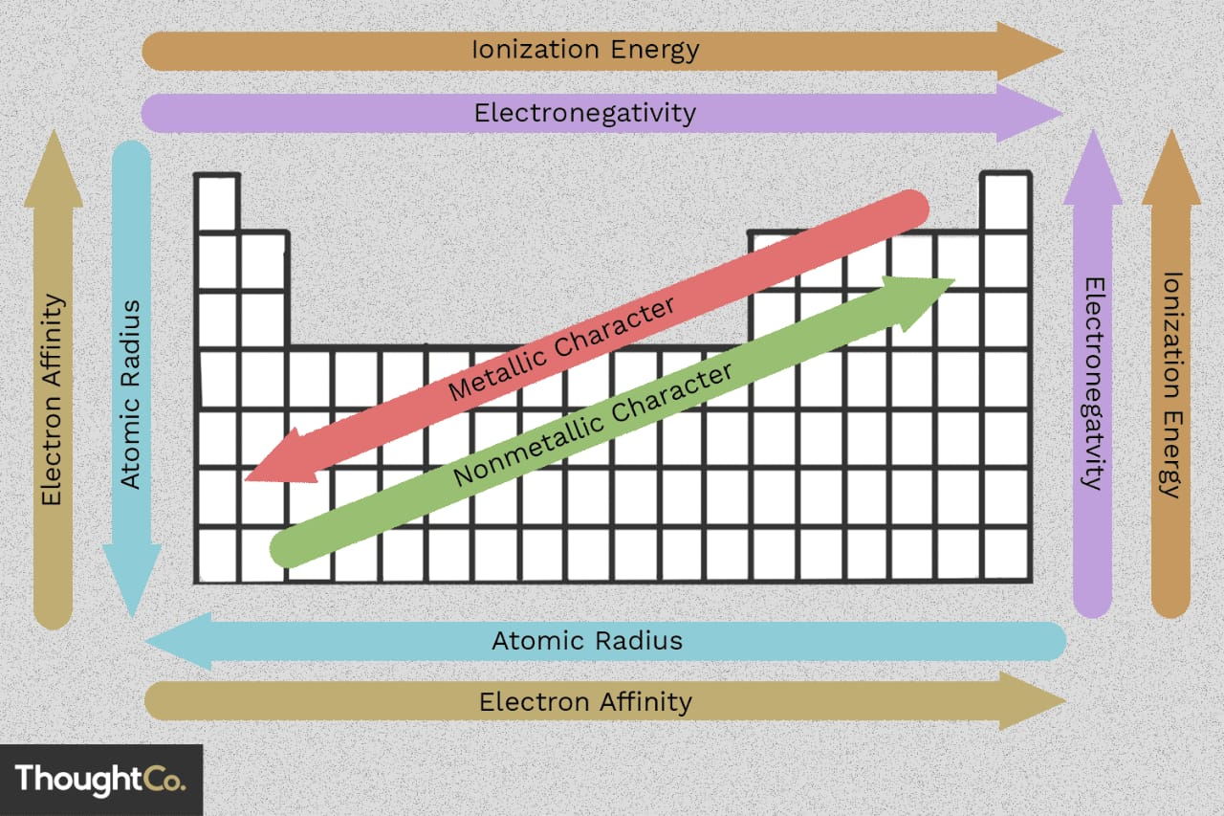
Ionic radii decrease
On conclusion
Ionic radii decrease

Slide 13
Thanks for staying with me

